Slide 1
ELEMENTARY STATISTICS, BLUMAN
Percentiles
© 2019 McGraw-Hill Education. All rights reserved. Authorized only for instructor use in the classroom. No reproduction or further distribution permitted without the prior written consent of McGraw-Hill Education.

Slide 2
Objectives for this PowerPoint
Understand percentile notation
Find the percentile ranking for a given data value

Slide 3
Percentiles
Percentiles divide a data set into 100 equal groups.
The symbol P₁₀ refers to the 10th percentile. It represents that point at which 10% of the data values lie below that value and 90% lie above.
For instance if your score on a standardized test places you in the 57th percentile then the symbol P₅₇ would be used to describe your relative position in the population. The interpretation of this symbol would be to say that 57% of the students taking that test scored below your score and 43% scored above.

Slide 4

Percentile Formula
The percentile corresponding to a given value X is computed by using the following formula:
$$Percentile=\frac{\left(number of values below X\right)+0.5}{total number of values}∙100$$

Slide 5
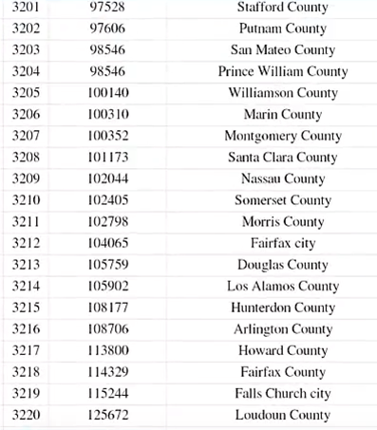
Example (1)
These data values represent the median household income for all counties in the United States including Puerto Rico according to the 2012-2016 American Community Survey. There is a total of 3220 data values.
Source: factfinder.census.gov 2012 – 2016 American Community Survey

Slide 6
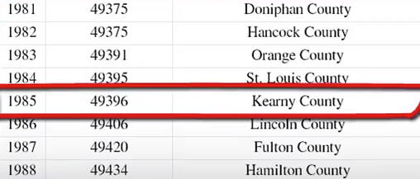
Example (2)
Suppose we wanted to find the percentile ranking for the median household income for Kearney County in the state of Kansas. According to the survey Kearney County is number 1,985 in the sorted list.
Kearney County is number 1,985 in the sorted list. The number of data values below would be 1,984.

Slide 7

Example (3)
The percentile corresponding to a given value X is computed by using the following formula:
$$Percentile=\frac{\left(number of values below\right)+0.5}{total number of values}∙100$$
$$Percentile=\frac{1984+0.5}{3220}∙100=\frac{1984.5}{3220}∙100=62$$
Percentiles should be reported as whole numbers. If we include decimal places it implies more than a hundred positions in the data set.

Slide 8
Example (4)
We would use the notation P₆₂ which would be interpreted by saying 62% of the counties in the US have a smaller median household income and 38% have a higher median household income.

Slide 9
Summary
In this PowerPoint we learned how to interpret the meaning of percentile notation and how to find the percentile ranking for a given data value.

